Slide 1
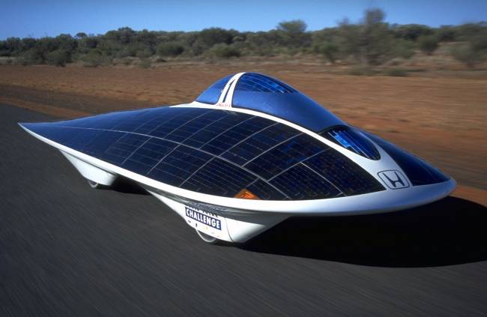
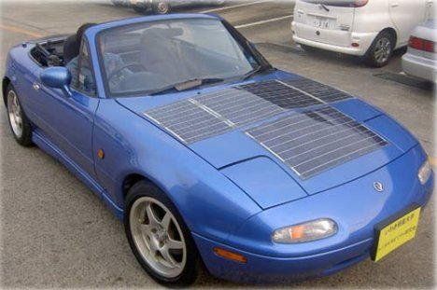
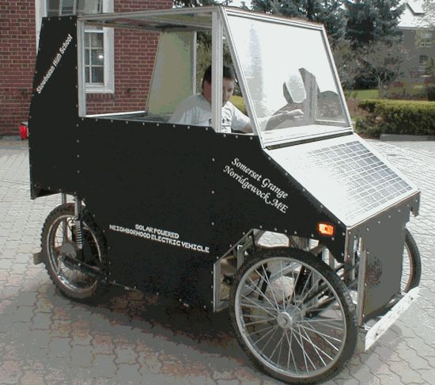
Solar Powered Cars

Slide 2

Solar Cars
Definition: A car which uses sunlight to charge batteries which inturn power the motors that drive the car.

Slide 3
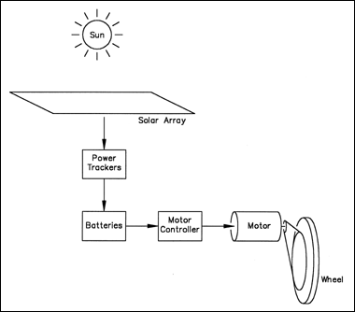
Solar Car Components
Solar Array
2) Power Transformer
3) Batteries
4) Motor & Controller

Slide 4
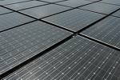
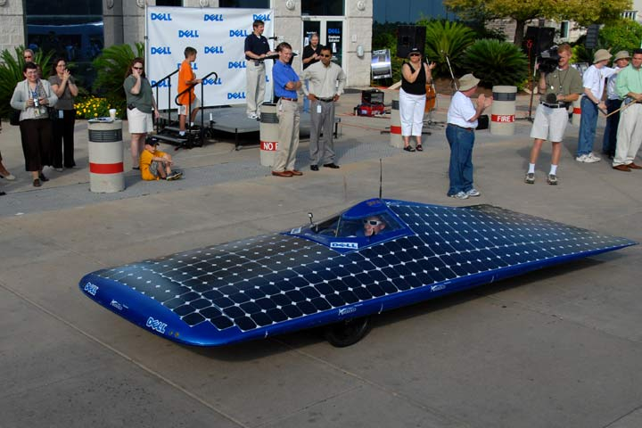
Solar Array
Grouping of solar cells that collect the energy from the sun and converts it into usable electrical energy.

Slide 5
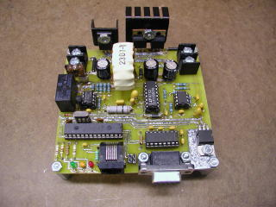
Power Transformers
Solar Power transformer also called power trackers, converts the solar array voltage to the system voltage.

Slide 6
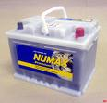
Batteries
The batteries store energy from the solar array/transformer.
The power is stored in the battery, where it waits to be used by the motor.

Slide 7
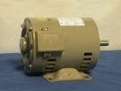
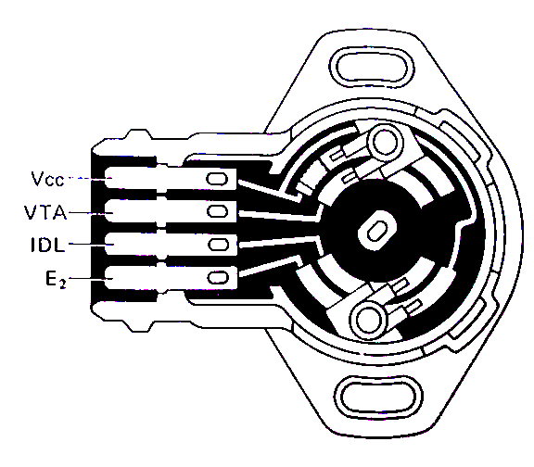
Motor & Regulator
The motor uses that energy to drive the wheels
The motor regulator or controller adjusts the amount of energy that flows to the motor in reference to throttle position.

Slide 8

Solar Car Pro’s
!Energy source is free!

Slide 9
Problems with Solar Cars
Solar Cars are not a realistic alternative to “normal” cars, due to:
  Limited power and performance.
  Limited range.
  Discontinuous energy source.
  High cost.
Notes:
9

Slide 10
Questions
What makes a solar power truly renewable?
What are the biggest drawbacks to using solar to power a car?
Could you take a Solar powered car to a drive in? Is there any way you could?

Slide 11
Model Solar Car Project
Brain Storming
Break into Assigned Groups
Brainstorm some initial ideas regarding the task
ASK Questions!!! If you are unsure of what needs to be done…

